Slide 1
Logistics
Next week: project update
Thursday: class is remote (zoom link on slack)

Slide 2
Project update 1
Your group has individual comments on Slack
Next steps should be completed next week’s project update
Common issue: what is a baseline?
Baselines solve the problem in your formulation: identify a top 10% of projects
Categorical features often don’t do this well because of many ties

Slide 3
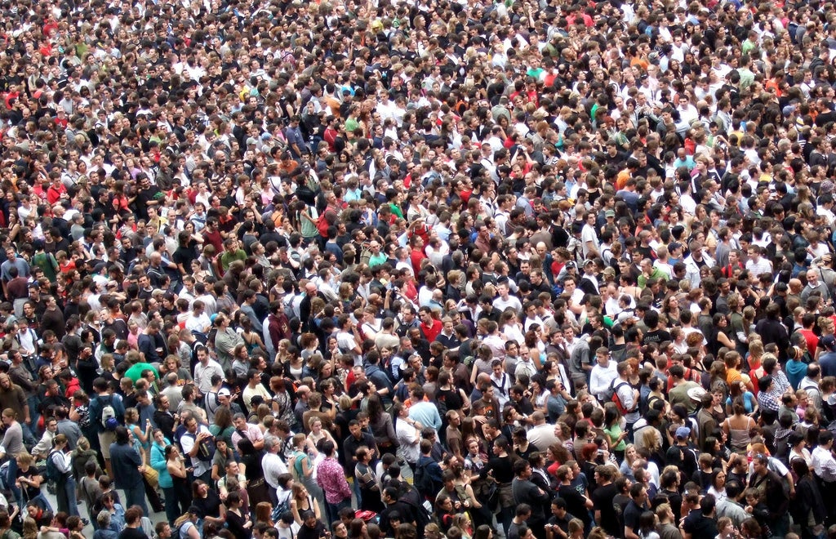
Deploying an AI-augmented intervention for HIV prevention
Bryan Wilder
(Carnegie Mellon)

Slide 4
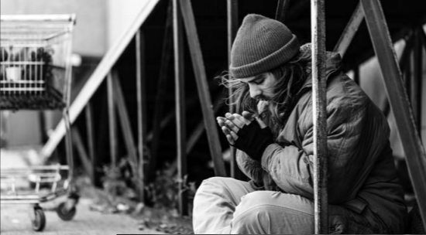


HIV and homelessness
500,000 youth experience homelessness each year in the US
10x HIV prevalence vs general population
Housing and Urban Development 2018 Homelessness Report

Slide 5
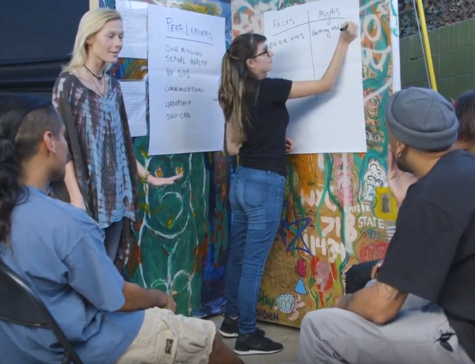
HIV and homelessness
Centers hold educational interventions
Resource constraints: limited capacity
Peer leaders: spread message through social network

Slide 6
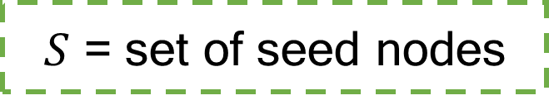
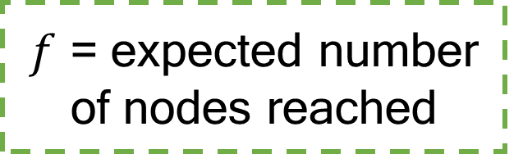
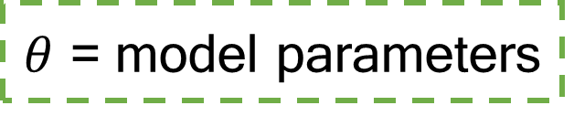
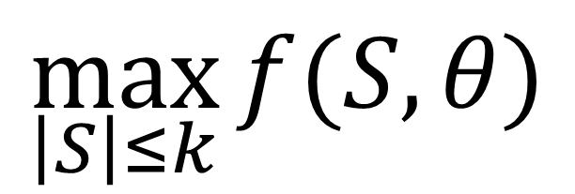
Computational problem
Recruit limited budget of $k$ seed nodes from a graph
$$\max_{\left|S\right|≤k}{f(S, θ)}$$
$θ$ = model parameters
$f$ = expected number of nodes reached
$S$ = set of seed nodes

Slide 7
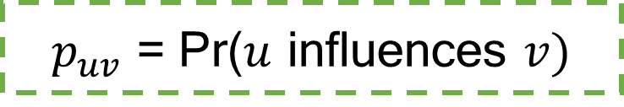
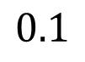
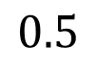
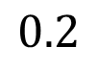
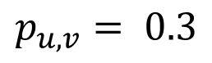
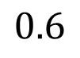
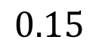
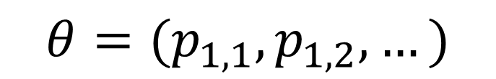
Independent cascade model
(Most common model in the literature)
v
$p_{uv}$ = Pr($u$ influences $v)$
$$p_{u,v}= 0.3$$
$$0.5$$
u
$$0.2$$
$$0.6$$
$$0.1$$
$$θ=(p_{1,1}, p_{1,2}, …)$$
$$0.15$$

Slide 8
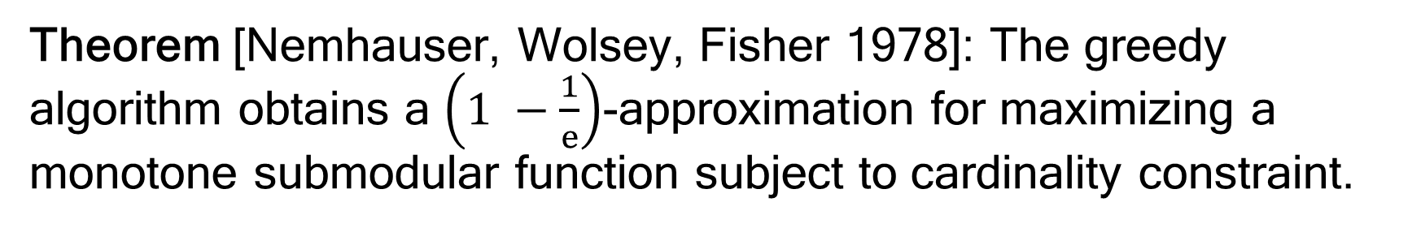
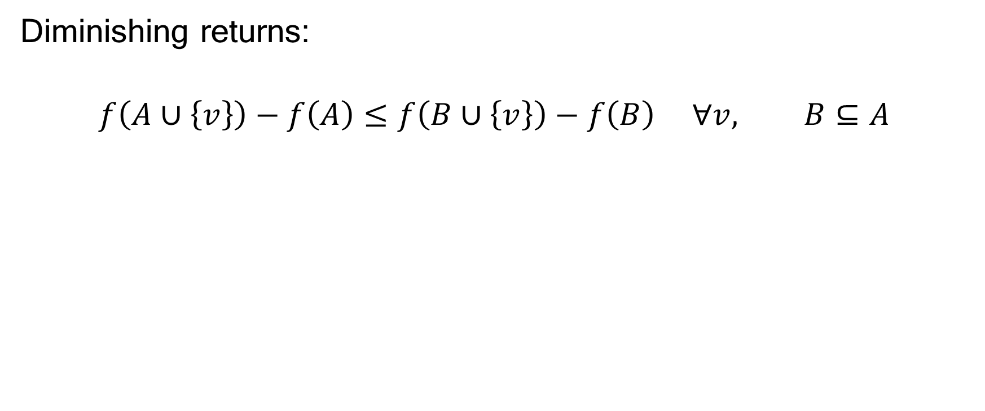
Background: submodularity
Diminishing returns:
$$f\left(A∪\left\{v\right\}\right)−f\left(A\right)≤f\left(B∪\left\{v\right\}\right)−f\left(B\right) ∀v, B⊆A$$
Theorem [Nemhauser, Wolsey, Fisher 1978]: The greedy algorithm obtains a $\left(1 −\frac{1}{e}\right)$-approximation for maximizing a monotone submodular function subject to cardinality constraint.

Slide 9
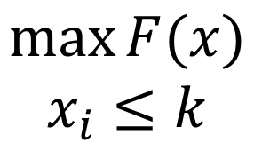
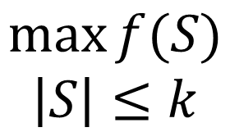
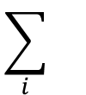
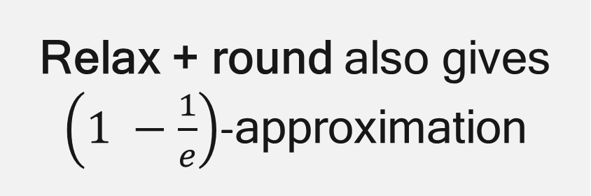

Background: alternate approach
Discrete problem
Continuous relaxation
$$\max{f(S)}$$
$$\left|S\right|≤k$$
$$\max{F(x)}$$
$$x_{i}≤k$$
$$\sum_{i}{}$$
$$F\left(x\right)=E_{S∼x}[f\left(S\right)]$$
Relax + round also gives $\left(1 −\frac{1}{e}\right)$-approximation

Slide 10


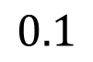
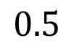

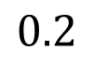
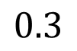

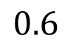

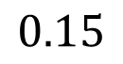

Influence maximization in the field
Previous work applies these techniques to influence maximization…
[Kempe et al 2003, Chen et al 2011, Tang et al 2014…]
But assume graph + parameters are known exactly!
$$0.3$$
$$?$$
$$0.5$$
$$?$$
$$0.2$$
$$?$$
$$0.6$$
$$?$$
$$0.1$$
$$?$$
$$0.15$$
$$?$$

Slide 11
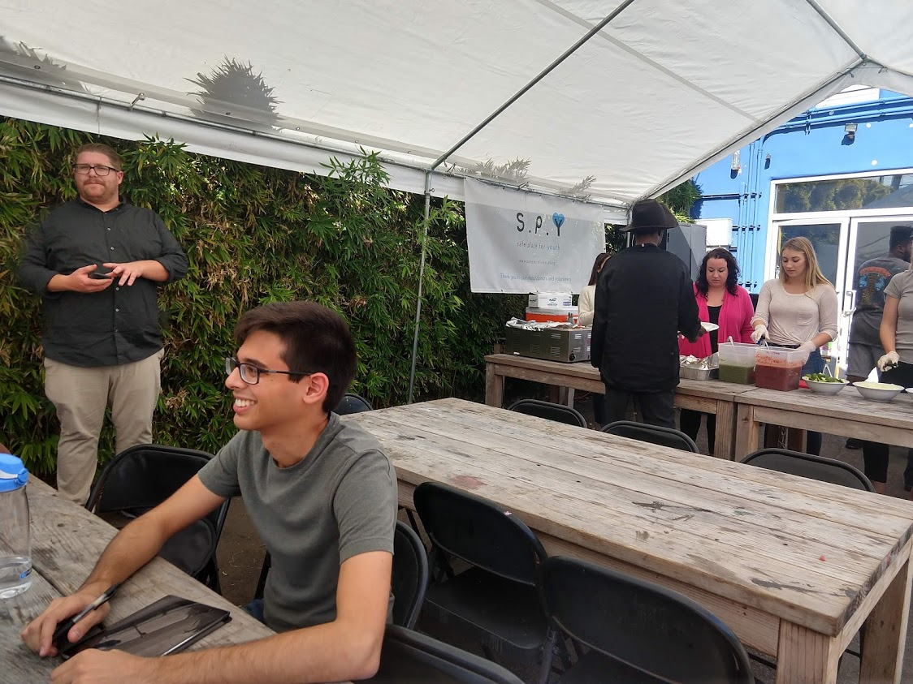



Field deployment of AI
With social work partners, developed AI-augmented intervention CHANGE
Trial with 700+ homeless youth over 2 years
Conducting surveys at SPY
First deployment of algorithmic methods for social network interventions in health

Slide 12
What if we don’t know the social network structure?
Gathering network data requires in-person surveys, week+ of effort
What if we don’t know the influence parameters?
Little-to-no data available about homeless youth populations

Slide 13
CHANGE, Part 1
What if we don’t know the social network structure?
Gathering network data requires in-person surveys, week+ of effort
What if we don’t know the influence parameters?
Little-to-no data available about homeless youth populations

Slide 14
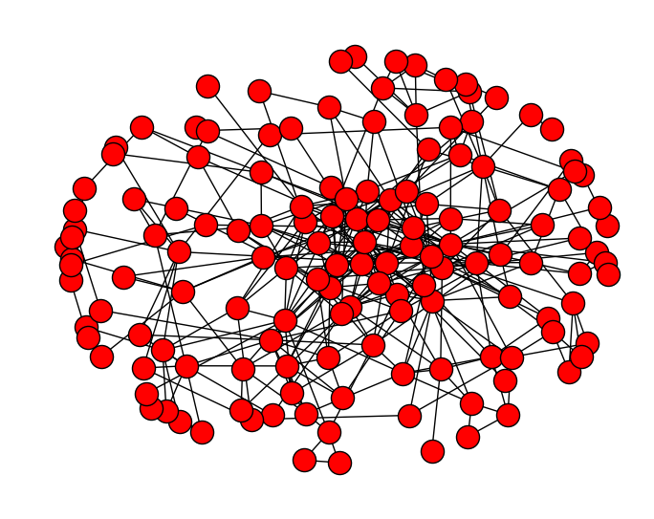
Where does the network come from?
Assumed start
Actual start
Assumed start
Actual start
?

Slide 15
Where does the network come from?
Data collection is costly and time consuming
Digital sources are often inaccurate or missing
Week+ to interview 100 or more people
Emerged as key issue in pilot tests

Slide 16
Where does the network come from?
Data collection is costly and time consuming
Digital sources are often inaccurate or missing
Week+ to interview 100 or more people
Emerged as key issue in pilot tests
Can we subsample the network to find influencers?

Slide 17
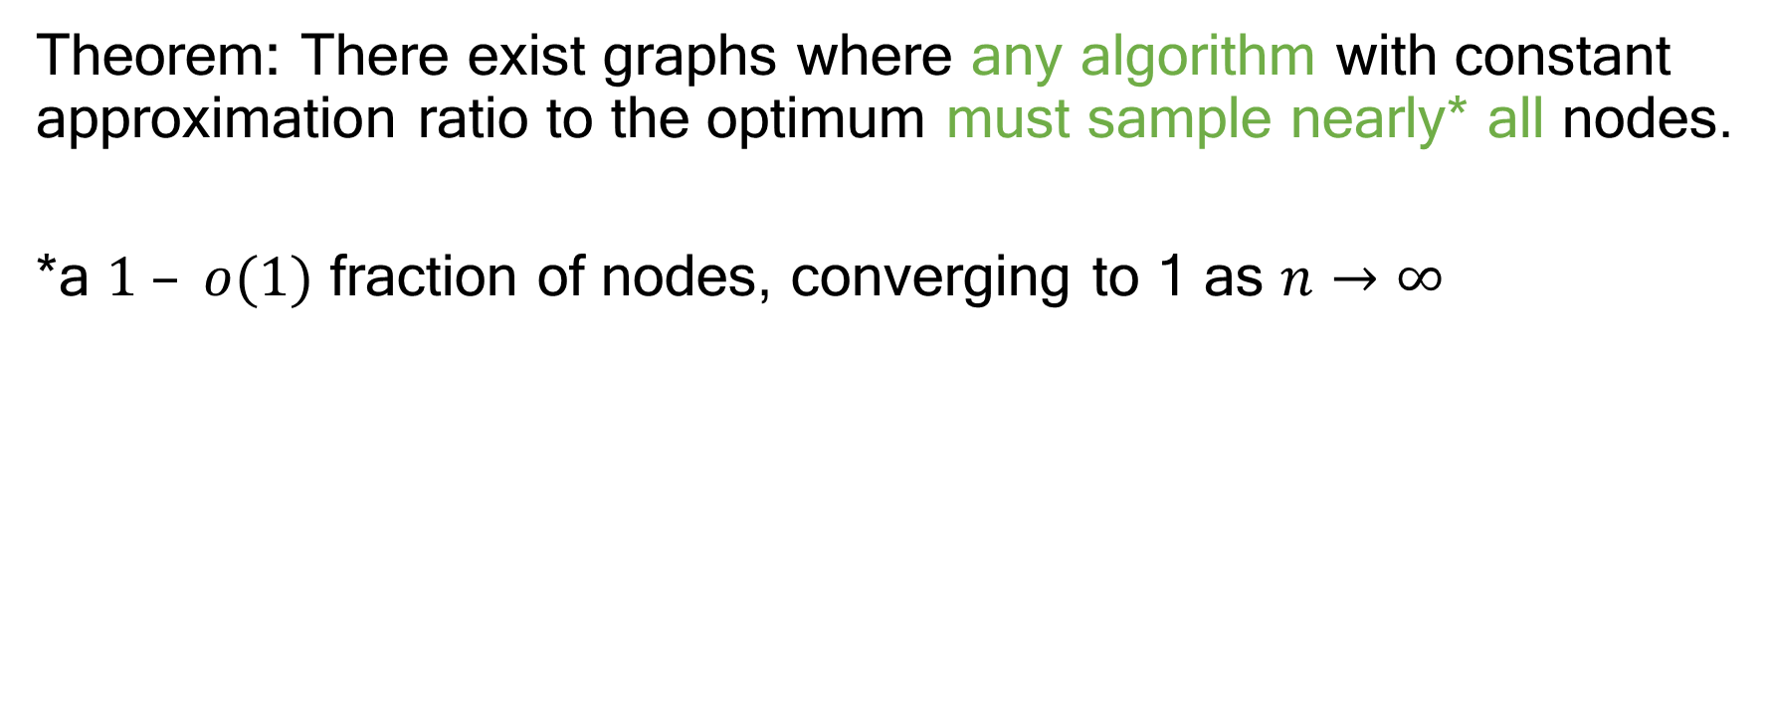
Hardness
Theorem: There exist graphs where any algorithm with constant approximation ratio to the optimum must sample nearly* all nodes.
*a $1 – o(1)$ fraction of nodes, converging to 1 as $n→∞$
Wilder, Immorlica, Tambe. Maximizing Influence in an Unknown Social Network. AAAI 2018.

Slide 18
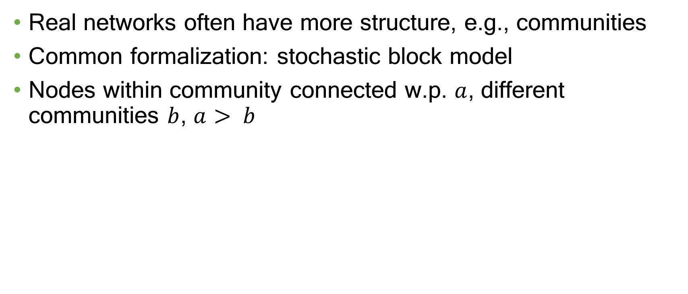
Community structure
Real networks often have more structure, e.g., communities
Common formalization: stochastic block model
Nodes within community connected w.p. $a$, different communities $b$, $a> b$
Wilder, Immorlica, Tambe. Maximizing Influence in an Unknown Social Network. AAAI 2018.

Slide 19
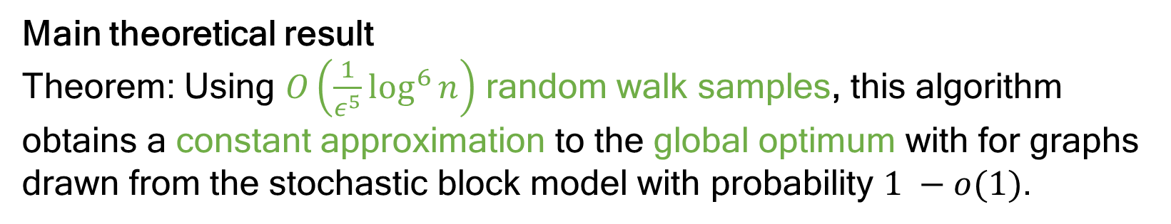
Community structure
Network sampling algorithm motivated by community structure
Theoretical analysis in stochastic block model
Main theoretical result
Theorem: Using $O\left(\frac{1}{ε^{5}}\log^{6}{n}\right)$ random walk samples, this algorithm obtains a constant approximation to the global optimum with for graphs drawn from the stochastic block model with probability $1 −o(1)$.
Wilder, Immorlica, Tambe. Maximizing Influence in an Unknown Social Network. AAAI 2018.

Slide 20
Wilder, Immorlica, Tambe. Maximizing Influence in an Unknown Social Network. AAAI 2018.

Slide 21
Start: nothing known
Wilder, Immorlica, Tambe. Maximizing Influence in an Unknown Social Network. AAAI 2018.

Slide 22
Choose a random node
Wilder, Immorlica, Tambe. Maximizing Influence in an Unknown Social Network. AAAI 2018.

Slide 23
Reveal neighbors
Wilder, Immorlica, Tambe. Maximizing Influence in an Unknown Social Network. AAAI 2018.

Slide 24
Random walk
Wilder, Immorlica, Tambe. Maximizing Influence in an Unknown Social Network. AAAI 2018.

Slide 25
Random walk
Wilder, Immorlica, Tambe. Maximizing Influence in an Unknown Social Network. AAAI 2018.

Slide 26
Random walk
Wilder, Immorlica, Tambe. Maximizing Influence in an Unknown Social Network. AAAI 2018.

Slide 27
More independent walks
Wilder, Immorlica, Tambe. Maximizing Influence in an Unknown Social Network. AAAI 2018.

Slide 28
More independent walks
Wilder, Immorlica, Tambe. Maximizing Influence in an Unknown Social Network. AAAI 2018.

Slide 29
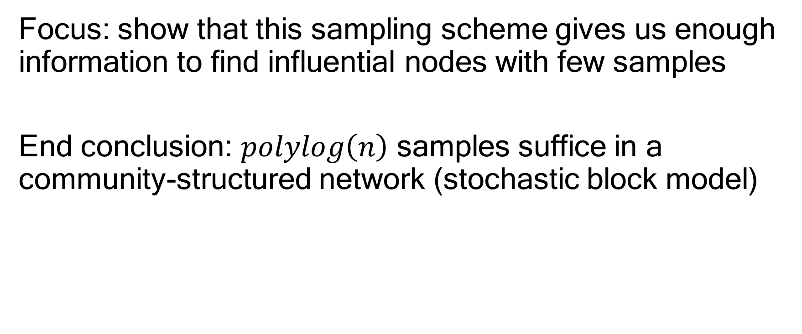
Theoretical analysis
Focus: show that this sampling scheme gives us enough information to find influential nodes with few samples
End conclusion: $polylog\left(n\right)$ samples suffice in a community-structured network (stochastic block model)
Wilder, Immorlica, Tambe. Maximizing Influence in an Unknown Social Network. AAAI 2018.

Slide 30
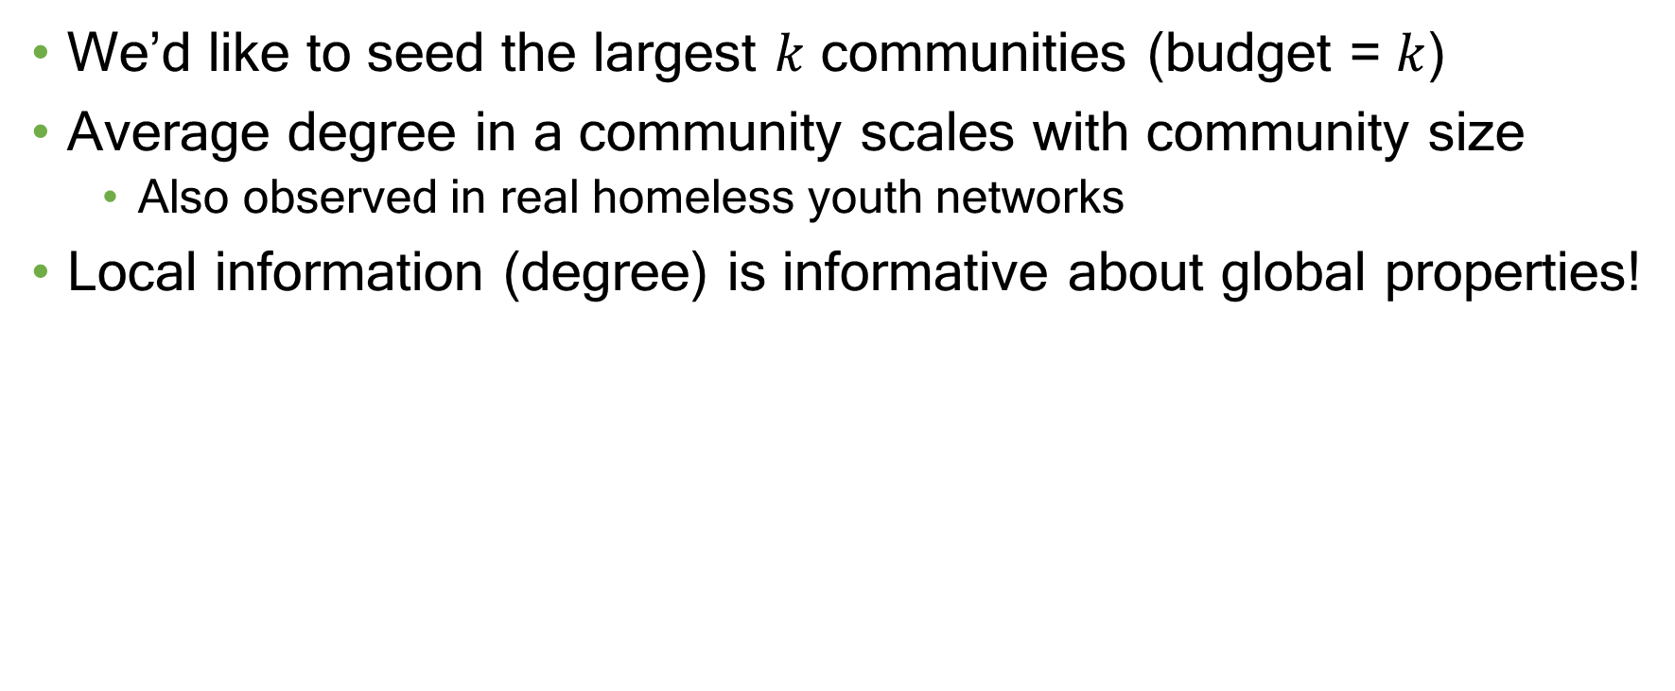

Intuition
We’d like to seed the largest $k$ communities (budget = $k$)
Average degree in a community scales with community size
Also observed in real homeless youth networks
Local information (degree) is informative about global properties!
Size $≈$ 50 nodes
Wilder, Immorlica, Tambe. Maximizing Influence in an Unknown Social Network. AAAI 2018.

Slide 31
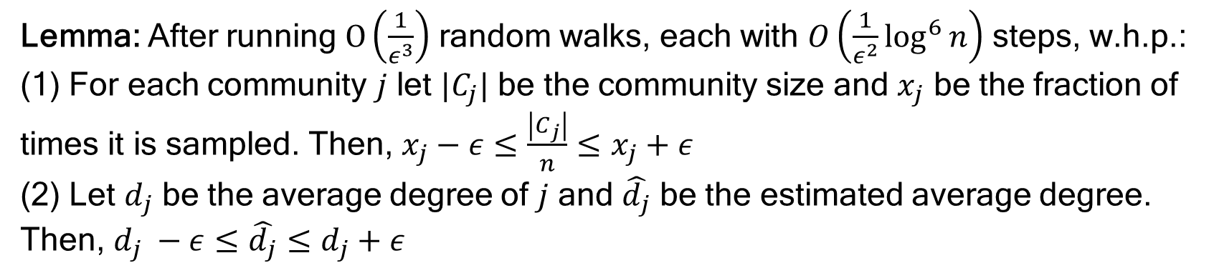
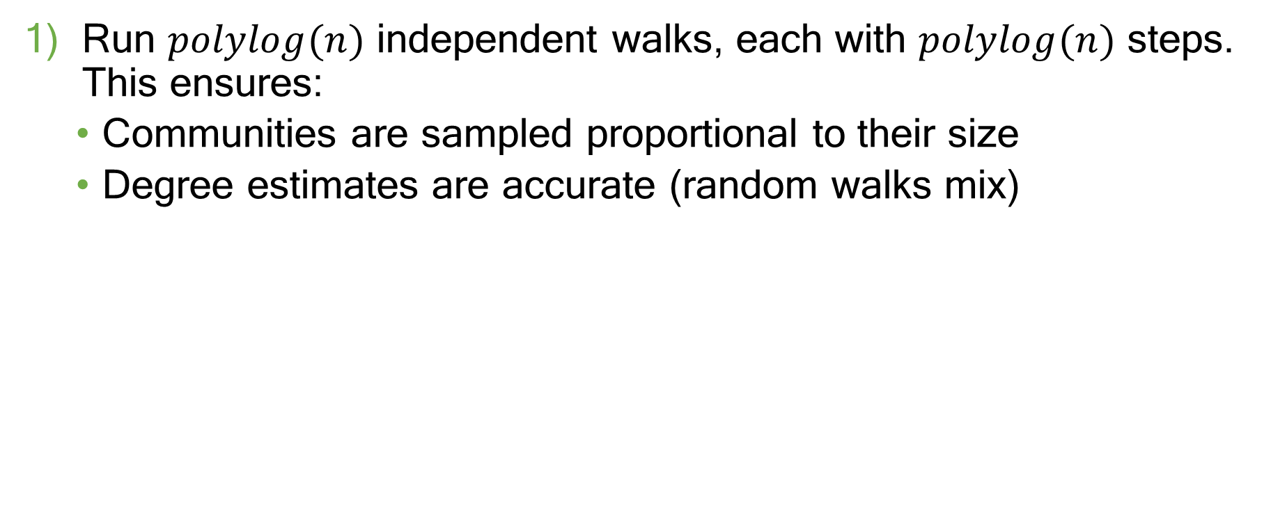
Algorithm sketch
Run $polylog(n)$ independent walks, each with $polylog(n)$ steps. This ensures:
Communities are sampled proportional to their size
Degree estimates are accurate (random walks mix)
Lemma: After running $O\left(\frac{1}{ε^{3}}\right)$ random walks, each with $O\left(\frac{1}{ε^{2}}\log^{6}{n}\right)$ steps, w.h.p.:
(1) For each community $j$ let $|C_{j}|$ be the community size and $x_{j}$ be the fraction of times it is sampled. Then, $x_{j}−ε≤\frac{\left|C_{j}\right|}{n}≤x_{j}+ε$
(2) Let $d_{j}$ be the average degree of $j$ and $\hat{d_{j}}$ be the estimated average degree. Then, $d_{j} −ε≤\hat{d_{j}}≤d_{j}+ε$
Wilder, Immorlica, Tambe. Maximizing Influence in an Unknown Social Network. AAAI 2018.

Slide 32
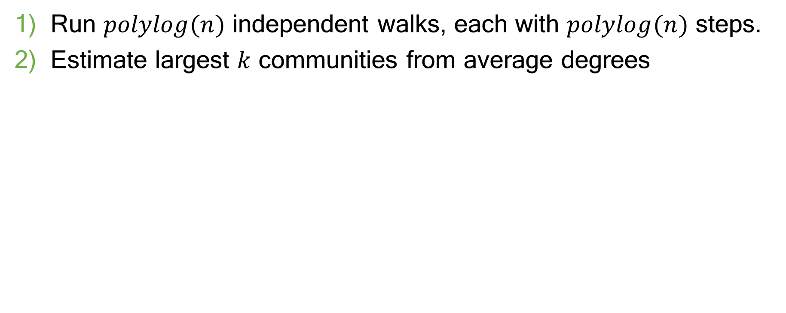
Algorithm sketch
Run $polylog(n)$ independent walks, each with $polylog(n)$ steps.
Estimate largest $k$ communities from average degrees
Lemma: After running $O\left(\frac{1}{ε^{3}}\right)$ random walks, each with $O\left(\frac{1}{ε^{2}}\log^{6}{n}\right)$ steps, w.h.p.:
(1) For each community $j$ let $|C_{j}|$ be the community size and $x_{j}$ be the fraction of times it is sampled. Then, $x_{j}−ε≤\frac{\left|C_{j}\right|}{n}≤x_{j}+ε$
(2) Let $d_{j}$ be the average degree of $j$ and $\hat{d_{j}}$ be the estimated average degree. Then, $d_{j} −ε≤\hat{d_{j}}≤d_{j}+ε$
Wilder, Immorlica, Tambe. Maximizing Influence in an Unknown Social Network. AAAI 2018.

Slide 33

Algorithm sketch
Run $polylog(n)$ independent walks, each with $polylog(n)$ steps.
Estimate largest $k$ communities from average degrees
Choose seeds to hit largest $k$ communities
Wilder, Immorlica, Tambe. Maximizing Influence in an Unknown Social Network. AAAI 2018.

Slide 34
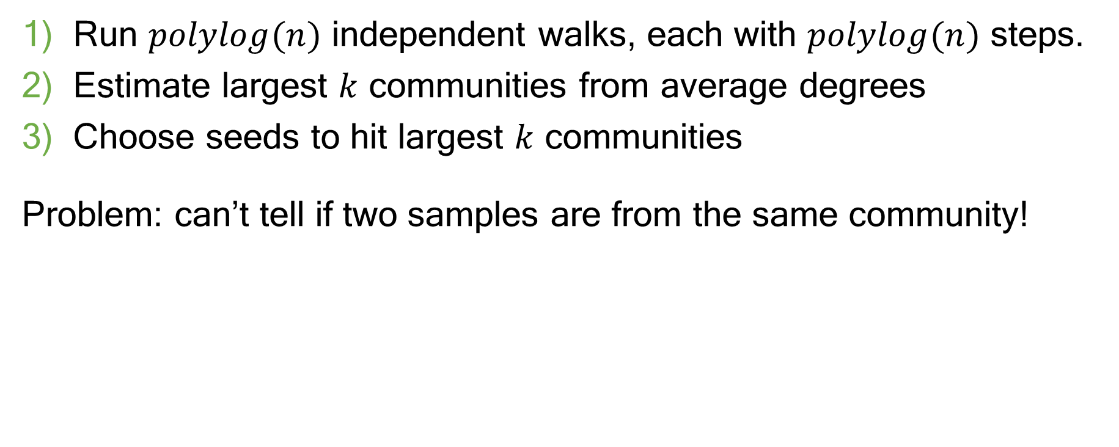
Algorithm sketch
Run $polylog(n)$ independent walks, each with $polylog(n)$ steps.
Estimate largest $k$ communities from average degrees
Choose seeds to hit largest $k$ communities
Problem: can’t tell if two samples are from the same community!
Wilder, Immorlica, Tambe. Maximizing Influence in an Unknown Social Network. AAAI 2018.

Slide 35
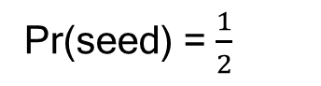
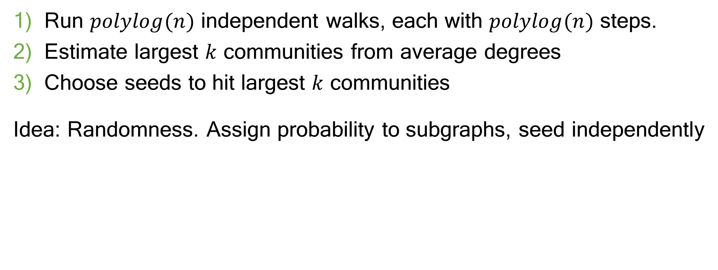
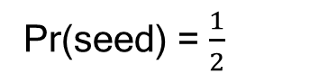
Algorithm sketch
Run $polylog(n)$ independent walks, each with $polylog(n)$ steps.
Estimate largest $k$ communities from average degrees
Choose seeds to hit largest $k$ communities
Idea: Randomness. Assign probability to subgraphs, seed independently
Pr(seed) = $\frac{1}{2}$
Pr(seed) = $\frac{1}{2}$
Wilder, Immorlica, Tambe. Maximizing Influence in an Unknown Social Network. AAAI 2018.

Slide 36
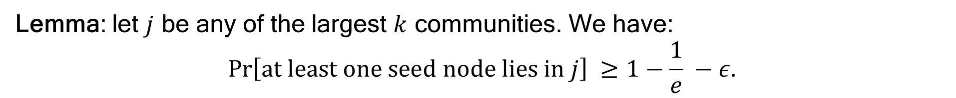
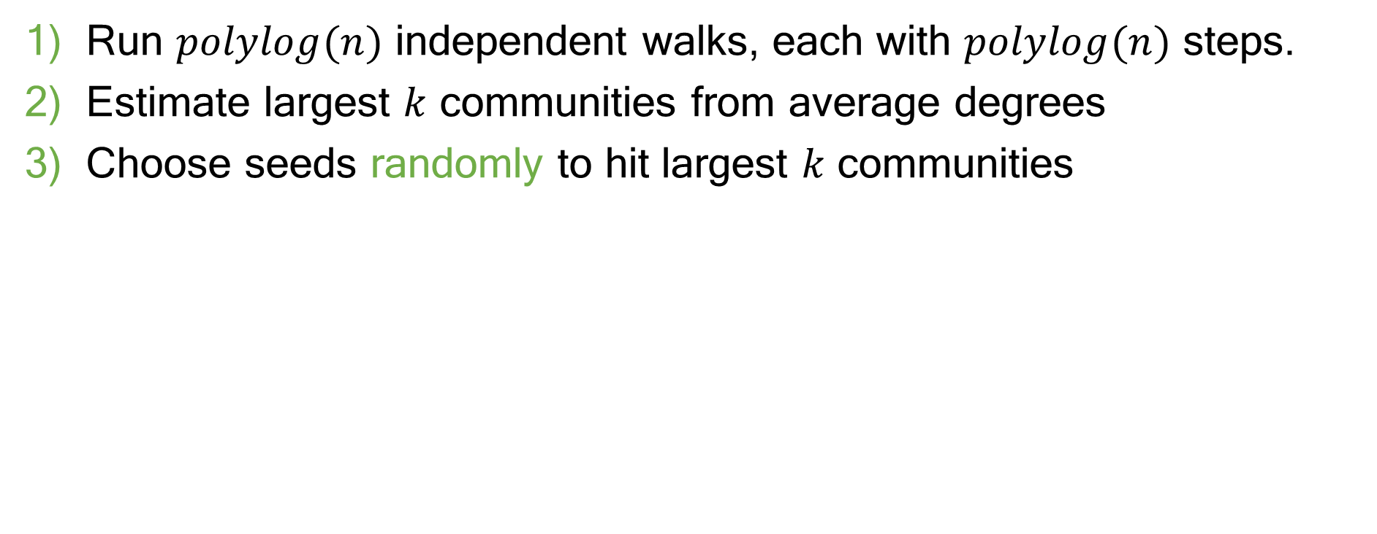
Algorithm sketch
Run $polylog(n)$ independent walks, each with $polylog(n)$ steps.
Estimate largest $k$ communities from average degrees
Choose seeds randomly to hit largest $k$ communities
Lemma: let $j$ be any of the largest $k$ communities. We have:
$$\operatorname{Pr}\left[at least one seed node lies in j\right] ≥1−\frac{1}{e} −ε.$$
Idea: balls-and-bins. Probability of seeding $≈{1 −\left(1 −\frac{1}{k}\right)}^{k}≥1 −\frac{1}{e}$
Wilder, Immorlica, Tambe. Maximizing Influence in an Unknown Social Network. AAAI 2018.

Slide 37
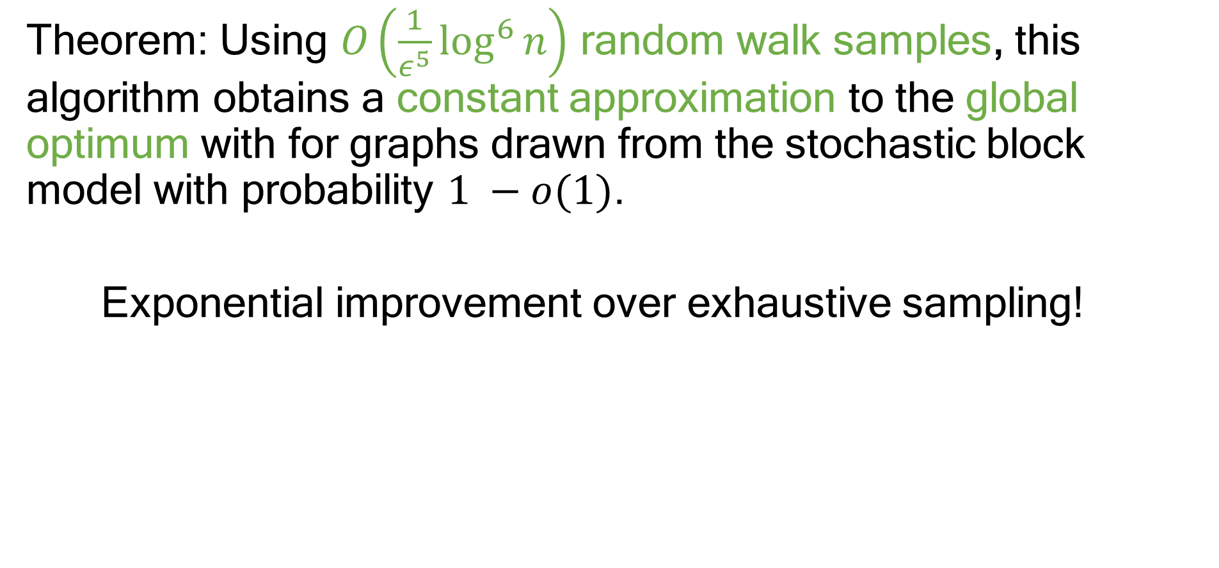
Theorem: Using $O\left(\frac{1}{ε^{5}}\log^{6}{n}\right)$ random walk samples, this algorithm obtains a constant approximation to the global optimum with for graphs drawn from the stochastic block model with probability $1 −o(1)$.
Exponential improvement over exhaustive sampling!
Wilder, Immorlica, Tambe. Maximizing Influence in an Unknown Social Network. AAAI 2018.

Slide 38
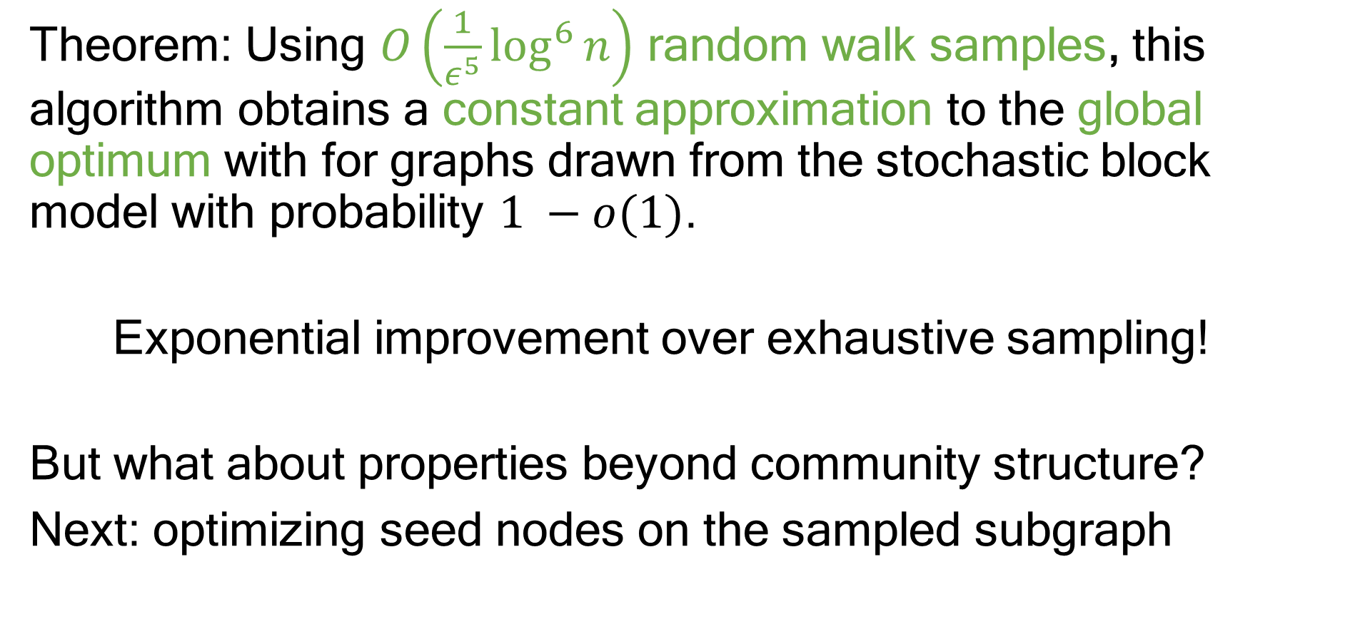
Theorem: Using $O\left(\frac{1}{ε^{5}}\log^{6}{n}\right)$ random walk samples, this algorithm obtains a constant approximation to the global optimum with for graphs drawn from the stochastic block model with probability $1 −o(1)$.
Exponential improvement over exhaustive sampling!
But what about properties beyond community structure?
Next: optimizing seed nodes on the sampled subgraph
Wilder, Immorlica, Tambe. Maximizing Influence in an Unknown Social Network. AAAI 2018.

Slide 39
What if we don’t know the social network structure?
Gathering network data requires in-person surveys, week+ of effort
CHANGE, Part 2
What if we don’t know the influence parameters?
Little-to-no data available about homeless youth populations

Slide 40
Another challenge
Random walk samples reveal partial network structure…
…but no way to elicit influence probabilities
$$0.3$$
$$?$$
$$0.5$$
$$?$$
$$0.2$$
$$?$$
$$0.6$$
$$?$$
$$0.1$$
$$?$$
$$0.15$$
$$?$$

Slide 41
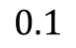
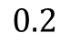
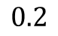
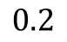
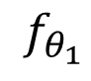

















Robust optimization
Given objectives $f_{1}…f_{m}$ induced by different parameters, solve
$$\max_{\left|S\right|≤k}{\min_{θ∈Θ}{f_{θ}(S)}}$$
$$0.3$$
$$0.1$$
$$0.7$$
$$0.5$$
$$0.7$$
$$0.2$$
$$0.2$$
$$0.9$$
$$0.5$$
$$0.6$$
$$0.2$$
$$0.4$$
$$0.1$$
$$0.3$$
$$0.6$$
…
$$0.15$$
$$0.4$$
$$0.2$$
$$f_{θ_{1}}$$
$$f_{θ_{2}}$$
$$f_{θ_{3}}$$

Slide 42
Robust optimization
Max-min is much harder than a single submodular function…
(NP-hard to even approximate, must relax)

Slide 43
Robust optimization
Max-min is much harder than a single submodular function…
(NP-hard to even approximate, must relax)
…and influence maximization has
exponentially many objectives (or more)

Slide 44



Distributionally robust optimization
All influence distributions close to estimate $\hat{θ}$
Measure with divergence, e.g., $χ^{2}$:
$$Θ=\{θ :d(θ, \hat{θ})≤ρ\}$$
$$\hat{θ}$$
Distributions close to $\hat{θ}$

Slide 45

Distributionally robust optimization
All influence distributions close to estimate $\hat{θ}$
Measure with divergence, e.g., $χ^{2}$:
$$Θ=\{θ :d(θ, \hat{θ})≤ρ\}$$
+ Handles model uncertainty
(e.g., distributions can have correlations)
$$\hat{θ}$$
Distributions close to $\hat{θ}$

Slide 46

Distributionally robust optimization
All influence distributions close to estimate $\hat{θ}$
Measure with divergence, e.g., $χ^{2}$:
$$Θ=\{θ :d(θ, \hat{θ})≤ρ\}$$
+ Handles model uncertainty
(e.g., distributions can have correlations)
+ Improves generalization when $\hat{θ}$ is
estimated from samples $ξ_{1}…ξ_{N}$:
$$\min_{θ∈Θ}{f(S, θ)}=\frac{1}{N}\sum{f(S, ξ_{i})}−\sqrt{\frac{2ρVar[f\left(S, ξ\right)]}{n}}$$
$$\hat{θ}$$
Distributions close to $\hat{θ}$
(c.f. Namkoong & Duchi 2017)

Slide 47

Distributionally robust optimization
All influence distributions close to estimate $\hat{θ}$
Measure with divergence, e.g., $χ^{2}$:
$$Θ=\{θ :d(θ, \hat{θ})≤ρ\}$$
+ Handles model uncertainty
(e.g., distributions can have correlations)
+ Improves generalization when $\hat{θ}$ is
estimated from samples $ξ_{1}…ξ_{N}$
- Infinite number of distributions ($m=∞)$!
$$\hat{θ}$$
Distributions close to $\hat{θ}$

Slide 48




Robust submodular optimization
$$|Θ|=poly(n)$$
$$|Θ|=\exp{(n)}$$
$$|Θ|=∞$$
Existing approaches:
Small # of objectives
This work:
Many objectives
Efficient optimization via continuous relaxation
Works whenever we can find $\underset{θ}{argmin}{f_{θ}(S)}$ for fixed $S$
[Krause et al 2008; Chen et al 2017]
Exhaustively enumerate in greedy-style algorithm

Slide 49

Approach
Relax to a zero-sum game
$$\max_{p: distribution over sets}{\min_{θ∈Θ}{E_{S∼p}[f_{θ}(S)}}]$$
Now, optimizing over a continuous space!
Wilder. Equilibrium Computation and Robust Optimization for Zero-sum Games with Submodular Structure. AAAI 2018.

Slide 50

Approach
Let $F_{1}…F_{m}$ be the continuous relaxation of each objective
Strategy: maximize $G\left(x\right)=$ $\min_{θ}{F(x, θ)}$
Key technical contribution
Extending continuous approach to max-min
gives speedup with many objectives
Wilder. Equilibrium Computation and Robust Optimization for Zero-sum Games with Submodular Structure. AAAI 2018.

Slide 51
Algorithm sketch
Apply gradient-based method to the function $G\left(x\right)= min{F_{θ}(x)}$
Frank-Wolfe algorithm: extends to nonconvex/nonconcave setting
Get a (super)gradient of 𝐺 just by finding the minimum 𝜃
Never need to evaluate all gradients explicitly!
Technical issues: adding controlled randomness
Controlled random perturbations ensure smoothness of gradients
Use correlation gap to design randomization rounding procedure
Wilder. Equilibrium Computation and Robust Optimization for Zero-sum Games with Submodular Structure. AAAI 2018.

Slide 52

Approximation guarantee
Theorem: this algorithm gives a $\left(1 −\frac{1}{e} −ε\right)$-approximation to the optimal solution of the robust problem with $O\left(\frac{1}{ε^{4}}\right)$ gradient evaluations. For the case of distributionally robust optimization, this can be improved to $O\left(\frac{1}{ε^{3}}\right)$.
Wilder. Equilibrium Computation and Robust Optimization for Zero-sum Games with Submodular Structure. AAAI 2018.
Staib*, Wilder*, Jegelka. Distributionally robust submodular optimization. AISTATS 2019.

Slide 53
CHANGE
Network sampling
Short random walks
Wilder et al. End-to-End Influence Maximization in the Field. AAMAS 2018.

Slide 54
CHANGE
Network sampling
Robust optimization
Short random walks
Continuous relaxation
Wilder et al. End-to-End Influence Maximization in the Field. AAMAS 2018.

Slide 55
CHANGE
Network sampling
Robust optimization
Short random walks
Continuous relaxation
Wilder et al. End-to-End Influence Maximization in the Field. AAMAS 2018.

Slide 56
CHANGE
Network sampling
Robust optimization
Adaptive selection
Short random walks
Continuous relaxation
Wilder et al. End-to-End Influence Maximization in the Field. AAMAS 2018.

Slide 57
CHANGE
Network sampling
Robust optimization
Adaptive selection
Community health: imperfect attendance
Stochastic extension of objective function
Wilder et al. End-to-End Influence Maximization in the Field. AAMAS 2018.

Slide 58
Field deployment
Trial with 718 homeless youth over 2 years
Collaboration with three Los Angeles drop-in centers; USC School of Social Work
Conducting surveys at SPY
Significant improvement over status quo
Wilder et al. Clinical Trial of an AI-augmented Intervention for HIV Prevention in Youth Experiencing Homelessness. AAAI 2021.

Slide 59
Trial design: three arms
CHANGE
Degree Centrality
Control group
Our method
Standard in public health
Observation-only
Wilder et al. Clinical Trial of an AI-augmented Intervention for HIV Prevention in Youth Experiencing Homelessness. AAAI 2021.

Slide 60
Trial design: three arms
CHANGE
Degree Centrality
Control group
Wilder et al. Clinical Trial of an AI-augmented Intervention for HIV Prevention in Youth Experiencing Homelessness. AAAI 2021.

Slide 61

Each deployment
Baseline
Recruit 80 youth
Conduct baseline survey
Wilder et al. Clinical Trial of an AI-augmented Intervention for HIV Prevention in Youth Experiencing Homelessness. AAAI 2021.

Slide 62
Data collection
Demographics
Risk behavior: unprotected sex
Network structure
CHANGE: $∼$20% of nodes queried
Degree centrality: 100% queried
Conducting surveys at SPY
Wilder et al. Clinical Trial of an AI-augmented Intervention for HIV Prevention in Youth Experiencing Homelessness. AAAI 2021.

Slide 63

Each deployment
Baseline
Recruit 80 youth
Conduct baseline survey
Intervention
Train 10-12 peer leaders
Day-long class with 3-4 youth on HIV awareness + outreach and leadership skills
Weekly individual check-ins to reinforce progress and address setbacks
Wilder et al. Clinical Trial of an AI-augmented Intervention for HIV Prevention in Youth Experiencing Homelessness. AAAI 2021.

Slide 64
Each deployment
Baseline
Recruit 80 youth
Conduct baseline survey
Intervention
Train 10-12 peer leaders
Follow-up
Survey all 80 at 1 and 3 months
Behavior change?
Wilder et al. Clinical Trial of an AI-augmented Intervention for HIV Prevention in Youth Experiencing Homelessness. AAAI 2021.

Slide 65

Results
Condomless anal sex
Condomless vaginal sex
Wilder et al. Clinical Trial of an AI-augmented Intervention for HIV Prevention in Youth Experiencing Homelessness. AAAI 2021.
Faster and larger decrease in CHANGE group

Slide 66

Results
Statistical analysis, testing for significant improvement vs control
After controlling for demographics and baseline risk behaviors
(age, birth sex, transgender identity, LGBQ identity, race, committed relationship, housing status, drop-in center, baseline CAS, baseline CVS,…)
Condomless Anal Sex | Condomless Vaginal Sex
33% reduced risk $p$ < 0.05 | 21% reduced risk $p$ < 0.1
Insignificant | Insignificant
CHANGE
Degree Centrality
Wilder et al. Clinical Trial of an AI-augmented Intervention for HIV Prevention in Youth Experiencing Homelessness. AAAI 2021.

Slide 67
Lessons learned
Wilder et al. Clinical Trial of an AI-augmented Intervention for HIV Prevention in Youth Experiencing Homelessness. AAAI 2021.

Slide 68
Lessons learned
Data bottlenecks are where algorithm design pays off
A key challenge in community settings
Wilder et al. Clinical Trial of an AI-augmented Intervention for HIV Prevention in Youth Experiencing Homelessness. AAAI 2021.

Slide 69
Lessons learned
Data bottlenecks are where algorithm design pays off
A key challenge in community settings
The real problems often aren’t apparent from the outside
Theory is good, but paired with time in the field and pilot tests
Wilder et al. Clinical Trial of an AI-augmented Intervention for HIV Prevention in Youth Experiencing Homelessness. AAAI 2021.

Slide 70
Lessons learned
Data bottlenecks are where algorithm design pays off
A key challenge in community settings
The real problems often aren’t apparent from the outside
Theory is good, but paired with time in the field and pilot tests
Community trust is essential
Requires buy-in from youth, staff, social workers
Wilder et al. Clinical Trial of an AI-augmented Intervention for HIV Prevention in Youth Experiencing Homelessness. AAAI 2021.

